Slide 1
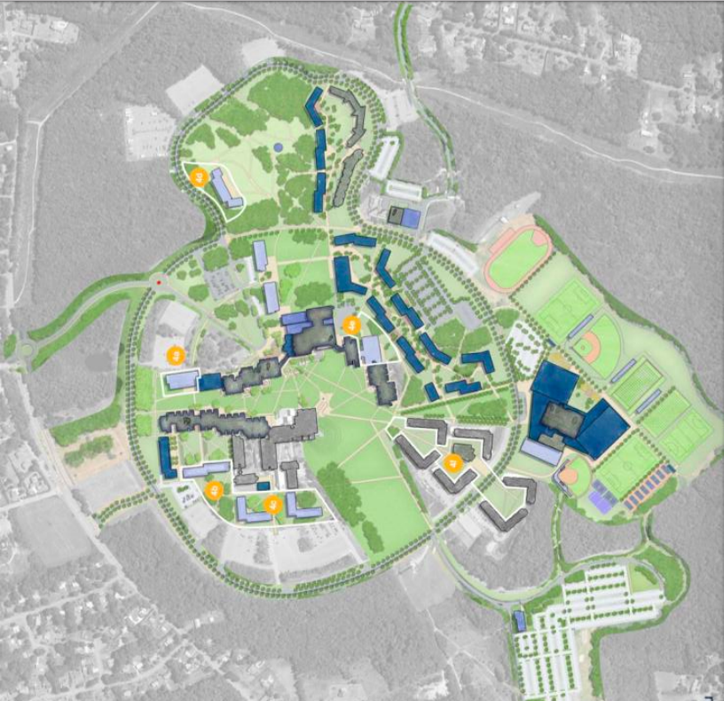
Campus Racing 2.5D
Amani, Andi, Hao, Jordan

Slide 2
Introduction
In this project, we decided to stick with the racing category as our main game idea. We used the map and car models which we created in project 1 and improved them in this game. We modified the controller and inserted a lot of new building models on the map to give a better gaming/racing experience to our players and to satisfy their requirements and expectations when they hear Campus Racing 2.5D!

Slide 3
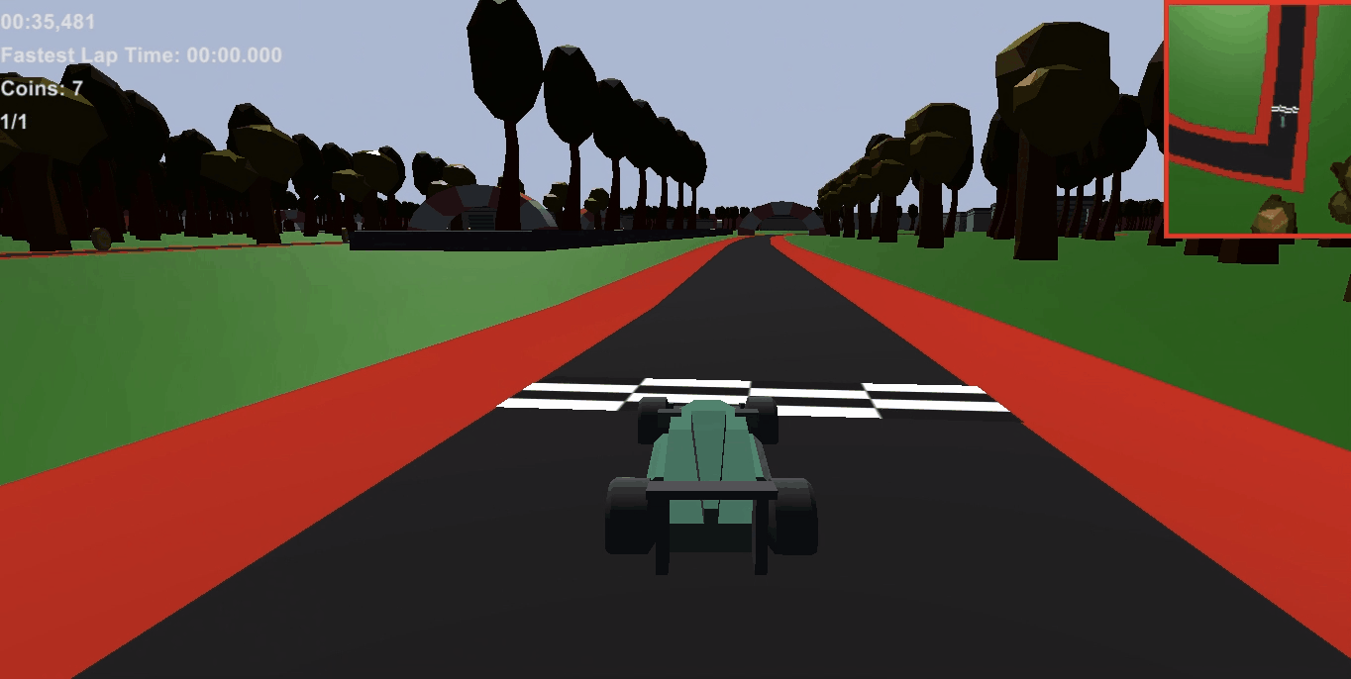
Car’s Movement and Controller
We used keyboard controls instead of the trackpad/mouse controls
W: accelerate forward, S: Reverse, A: Left turn, D: Right turn
Design Rule: To implement car’s acceleration and handling

Slide 4
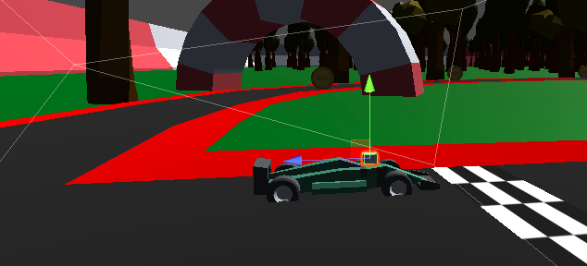
Camera
Create a new camera to replace the top-down camera for tracking car’s movement in real-time
Camera can change its angle and position immediately when the car takes any turn.
Design Rule: To provide a better driving perspective

Slide 5
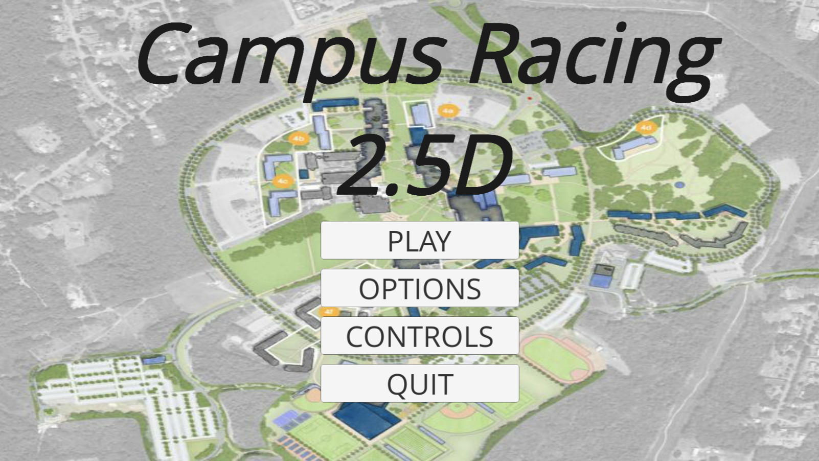
Game Menu
This is the main menu of the game
Includes: Options and Controls
Quit button

Slide 6
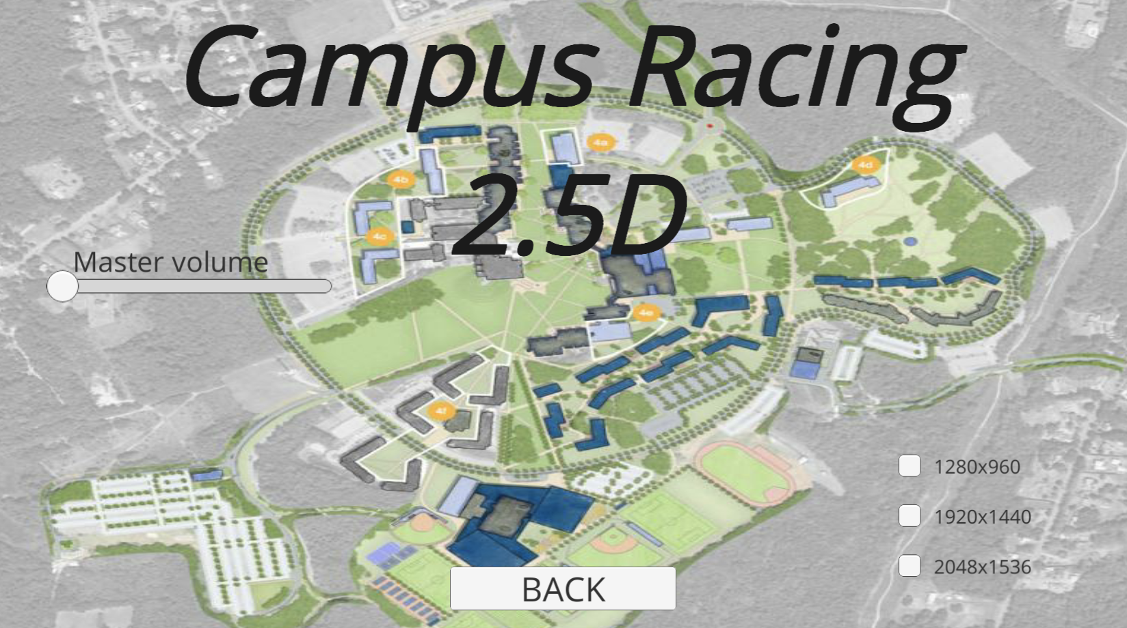
Game Menu
Options Menu contains:
Master Volume Slider
Resolution CheckBoxes
Back Button

Slide 7
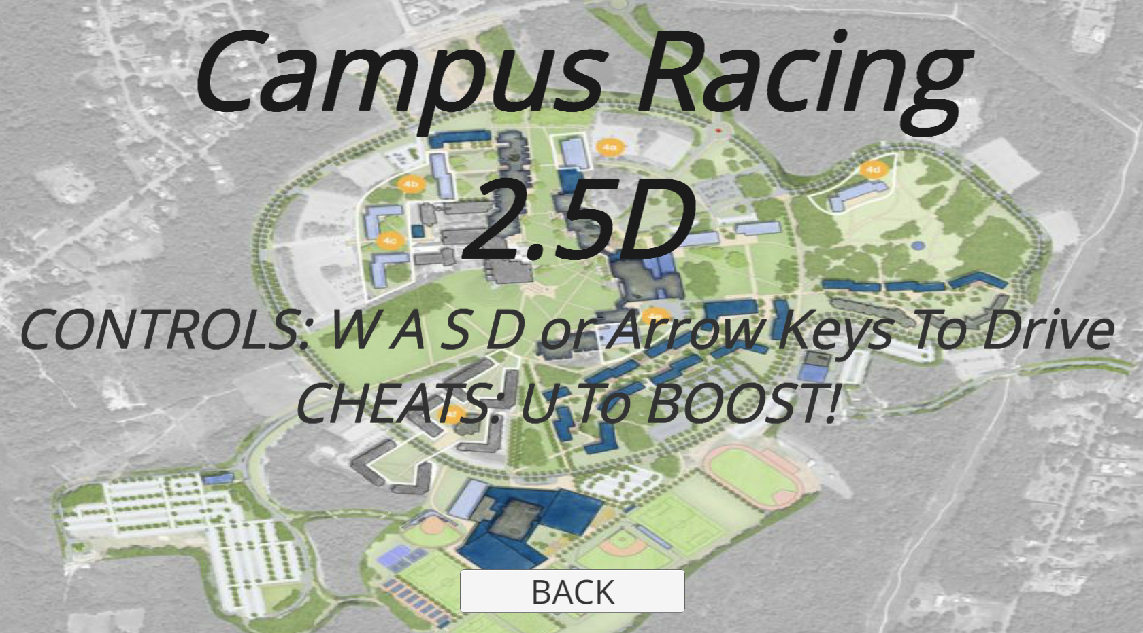
Game Menu
In game controls to help the user figure out how to play.
Cheats: Press U to boost!
Drive with W A S D or Arrow Keys

Slide 8
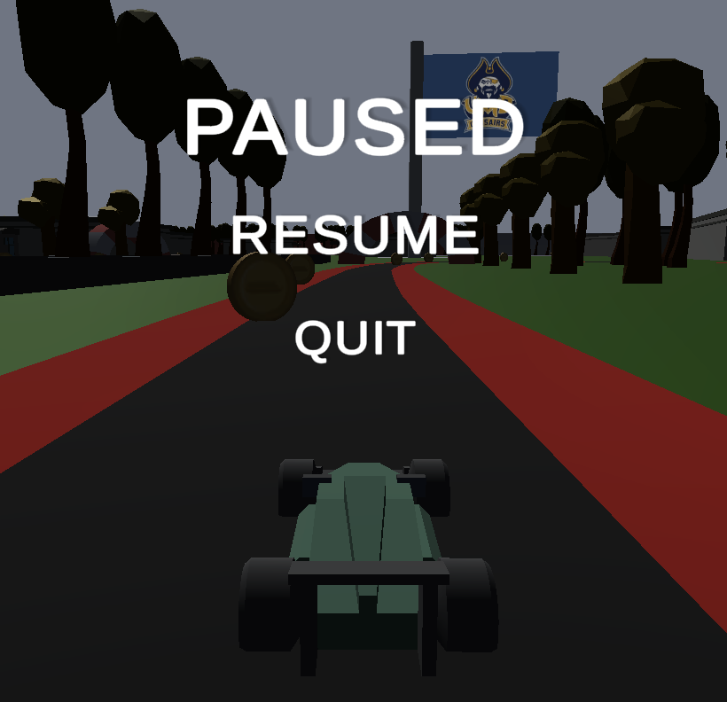
Pause Menu
Pause menu to be able to:
Resume the game
Quit the game

Slide 9
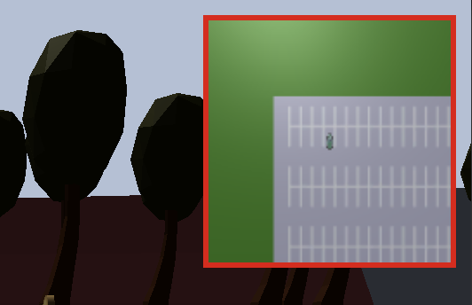
Minimap
Helps the player figure out where they are on the map
Zoomed out view of the nearby map

Slide 10
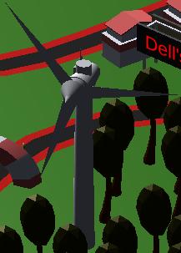
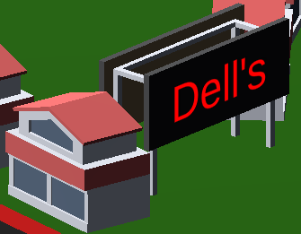
Map Design
Track is based on UMASS Dartmouth
We added 3D models
Class Buildings, Dorms, Billboards, Windmill, and a Flag!

Slide 11
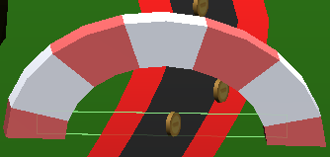
Checkpoints and Coins
There are visible checkpoints on the track
The red arch indicates where each checkpoint
There are 100 coins on the map to be collected while racing
Each coin are floating and spinning in the air
Notes:
When the player doesn’t go through the checkpoint they can’t finish the game

Slide 12
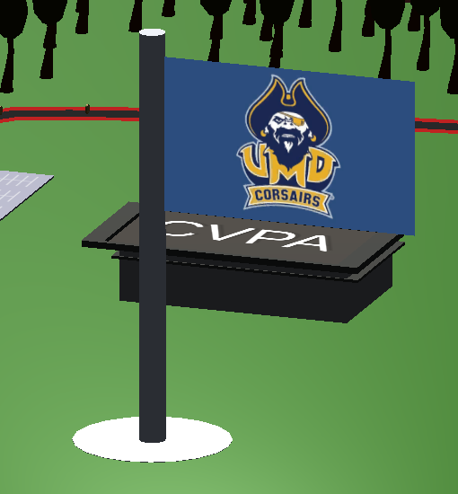
Assets
High quality models were chosen from the asset store to match the 3D design
A few custom models were made using Unity’s primitives

Slide 13
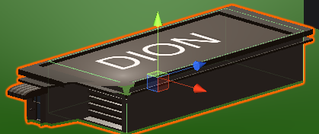
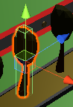
Collision
Different colliders were used depending on the details required
Trees: boxes
Pole: mesh
Buildings: mix

Slide 14
Features we just couldn’t implement
3 more tracks of all UMASS Colleges
Multiplayer/Bots
Player Customized Cars
Detailed paths on campus
Radio tower

Slide 15
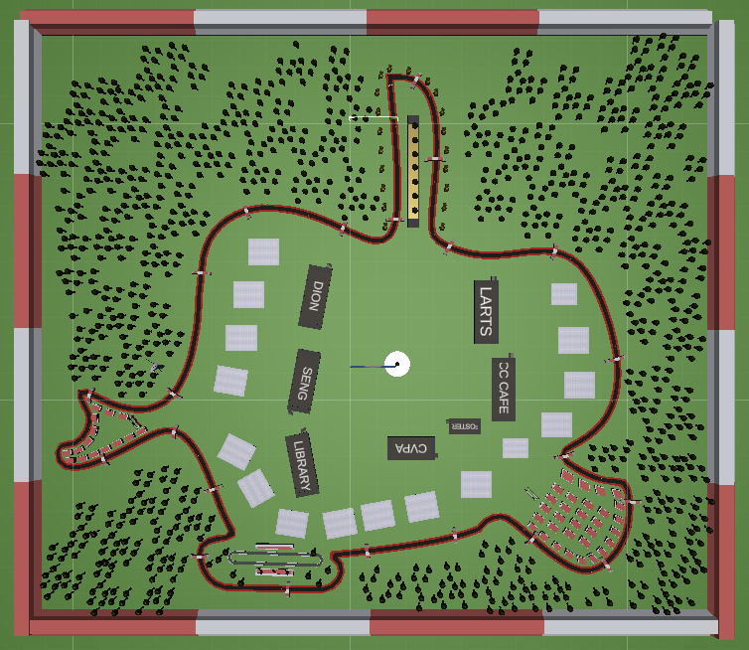
Demo

